Slide 1
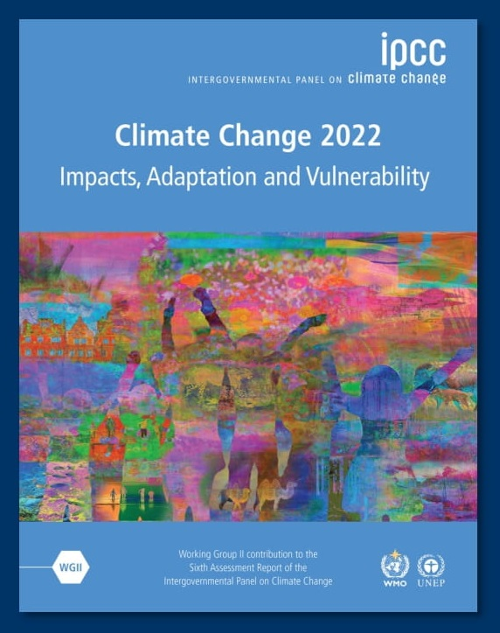
Overview of current climate change impacts assessments Global scale and Mexico
Notes:
Change name

Slide 2
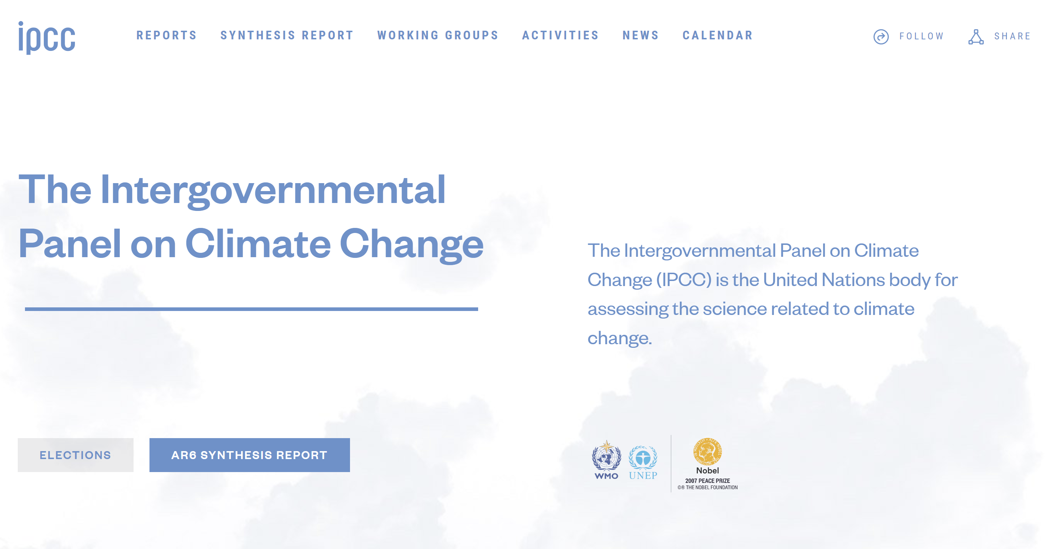
https://www.ipcc.ch/

Slide 3
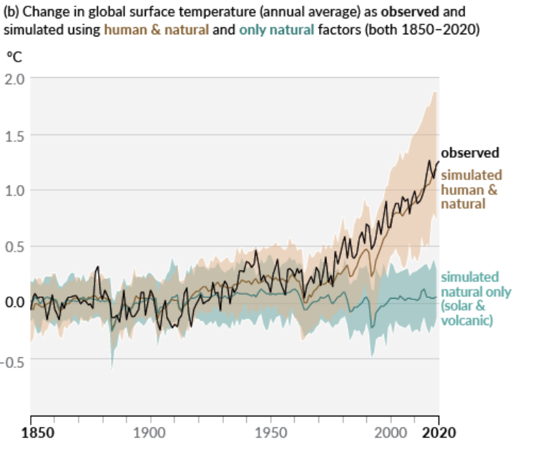
Climate Change Attribution
Conduct global model experiments that account for both natural and human factors
Attribution experiment incorporates human factors of greenhouse gases (warm) and aerosols (cool).
RESULT: NEED HUMAN FACTORS TO ACCOUNT FOR RECENLTY OBSERVED WARMING, ESPECIALLY AFTER 1980.
(CMIP6 and Shared Socio-economic Pathways Overview, 2019)

Slide 4
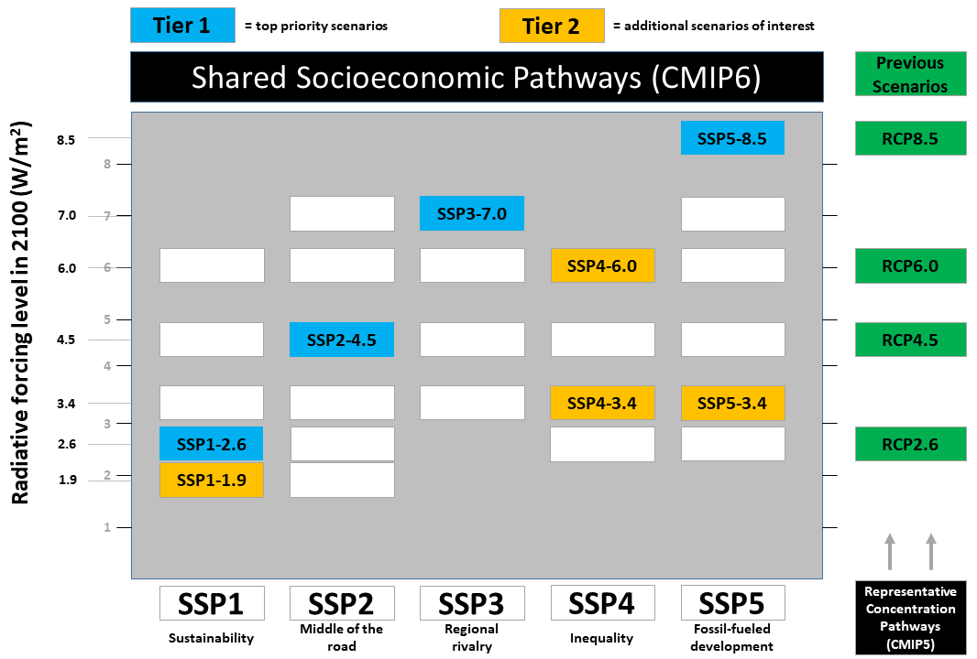
Emission scenarios for climate change projection models
These emission scenarios used to drive global climate model projection experiments, called coupled model intercomparison projects (CMIP)
CMIP6 models inform latest IPCC assessments. Comprised of approximately 20 global climate models from all over the world.
The global model simulations have a spatial resolution on the order of 100s of kilometers.
(CMIP6 and Shared Socio-economic Pathways Overview, 2019)

Slide 5
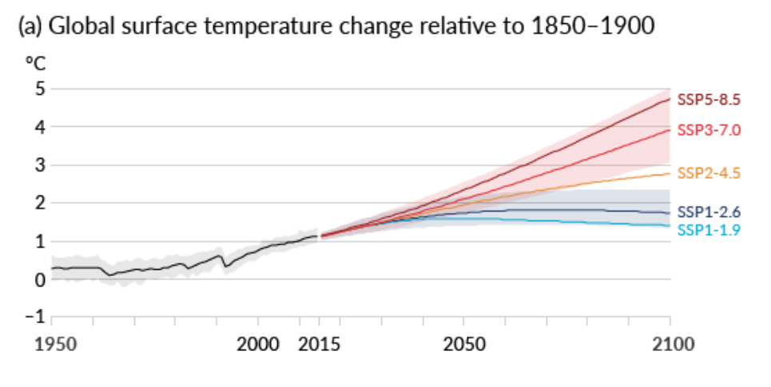
Projected Global Mean Temperature Increases
(CMIP6 and Shared Socio-economic Pathways Overview, 2019)

Slide 6
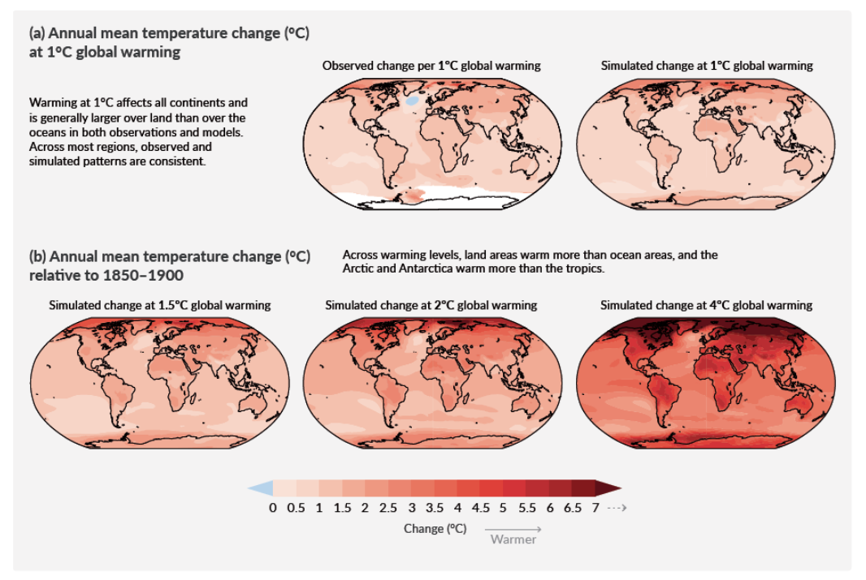
IPCC Assessment for Temperature Projections
For +4°C Global Warming, North American temperatures will be expected to rise 3-4°C.
Notes:
Rephrase title, latest assessment, projections

Slide 7
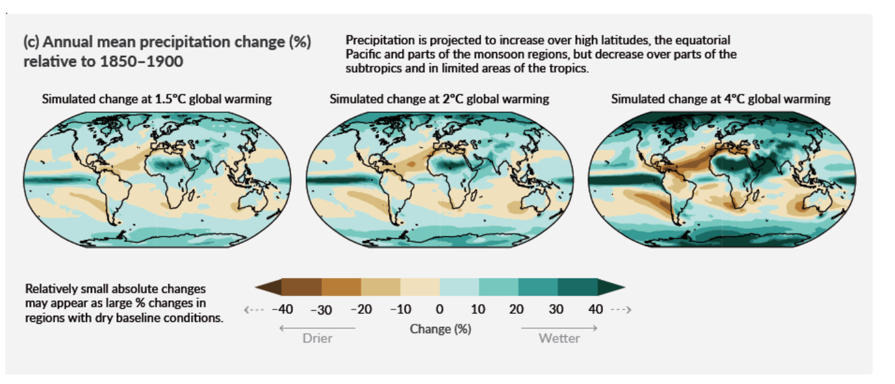
IPCC Assessment for Precipitation Projections
These global model projections are more uncertain, so necessary to create higher spatial scale of information using downscaling.
Notes:
Rephrase title, latest assessment, projections

Slide 8
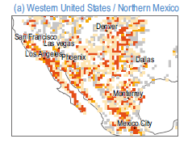
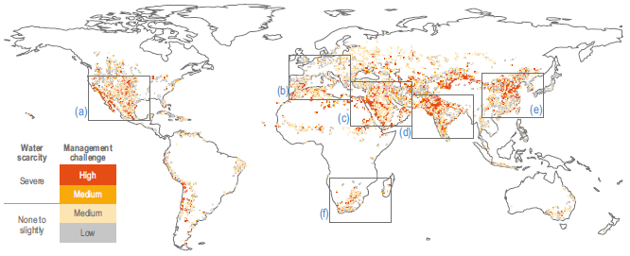
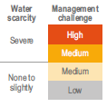
IPCC Assessment for Water Scarcity
Water supply globally expected to be burdened by 2050, mostly in subtropical areas
Southwest US and Mexico are one of the areas most impacted global due to overuse of limited water resources, especially groundwater, and greater heat stress.
Notes:
Rephrase title, latest assessment, projections

Slide 9
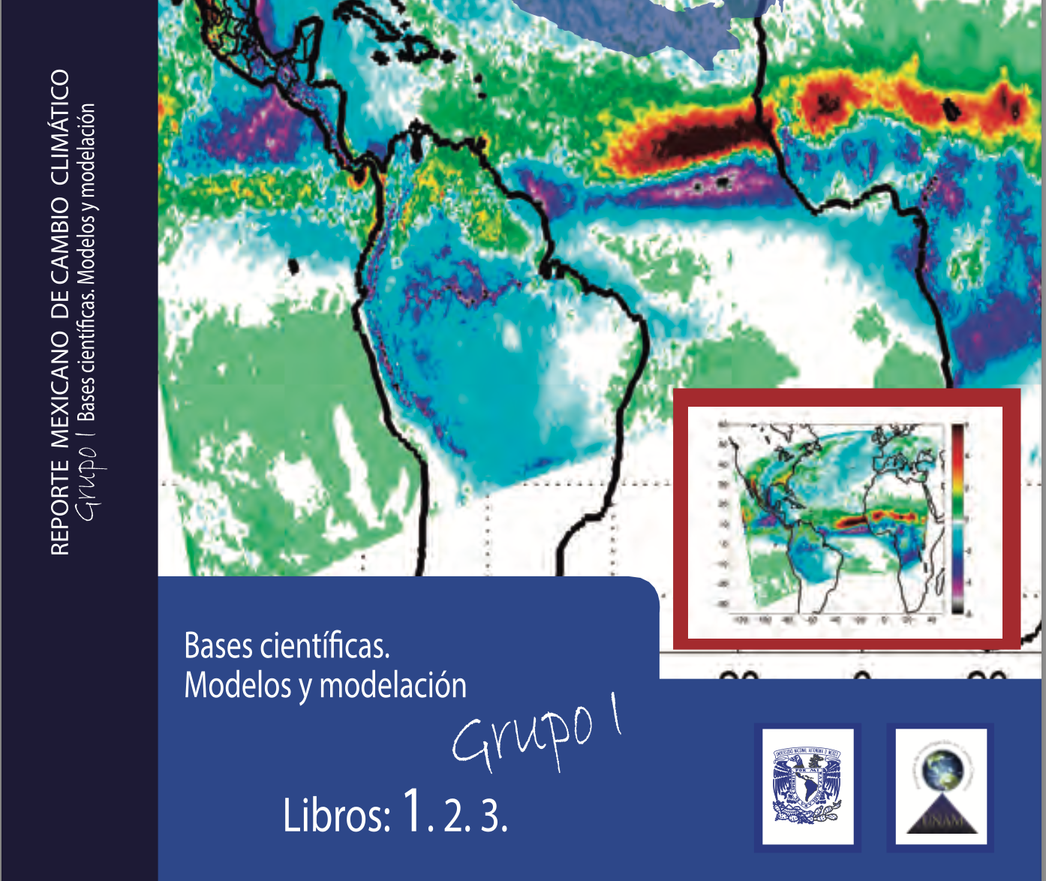
Climate assessment summary for Mexico Reporte Mexicano de Cambio Climático (RMCC)
Notes:
Compendium of the scientific foundations of climate change in Mexico, addressing the availability of information, both in the atmosphere and in the oceans.
Summary of climatic processes relevant to Mexico, as well as the state of the glaciers and what processes have played an important role in the evolution of the past climate.
Synthesis of the effects in the atmosphere associated with changes in the concentration and composition of aerosols
Review of ecosystems from a functional point of view. Advance knowledge about the interaction of climate variability and its links with biogeochemical cycles.

Slide 10
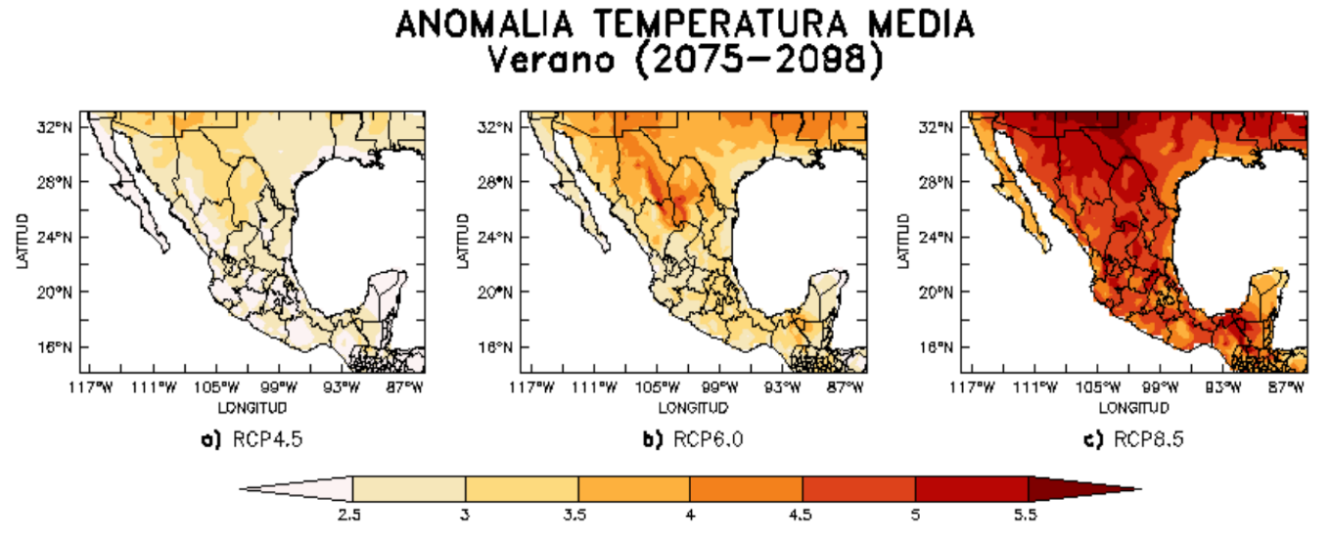
Assessment for Temperature Projections in Mexico
Mean annual temperature is expected to increase over Mexico
1.5°C – 5°C temperature increase under the scenarios of low (RCP4.5) and high (RCP8.5) emissions, respectively.
Northern Mexico is expected to become especially warmer during JAS

Slide 11
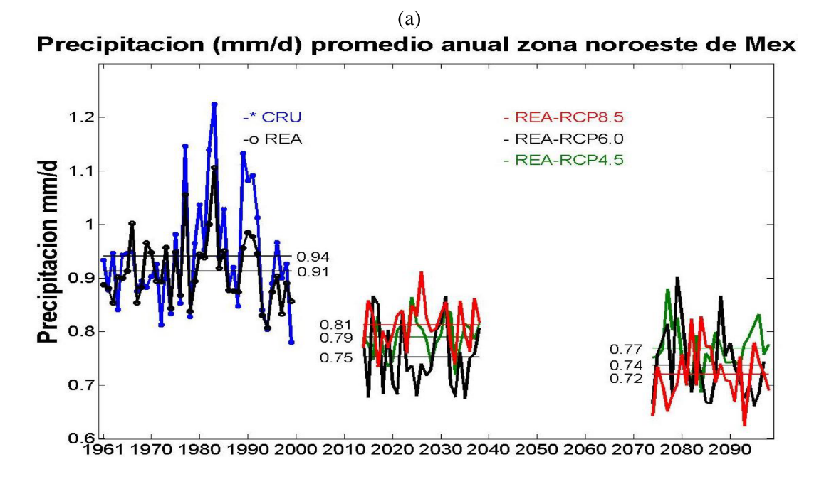
Assessment for Precipitation Projections in Mexico
Precipitation is projected to decrease over Mexico, at least as far as IPCC global climate models indicate.
Largest decreases in southern and central Mexico, mainly due to decreases in warm season precipitation and lengthened mid-summer drought.
Caveat here is these are global model projections, and these models are challenged to represent precipitation processes correctly in Mexico.

Slide 12
Drought Projections in Mexico
Intensification and earlier onset of the midsummer drought (partially dependent on ocean surface temperature)
High vulnerability of Mexico in this regard due to population exposure to water stress that could substantially increase in the future.

Slide 13
Potential Changes in Extreme Precipitation, with high resolution modeling
(Prein et al. 2016)
Higher resolution modeling (at kilometer scale) yields increases in precipitation in Mexico at the end of the 21st century, especially with respect to extremes.
Confident conclusion that extreme precipitation events will increase in a warming world, even if overall precipitation decreases, and this is likely true for Mexico.

Slide 14
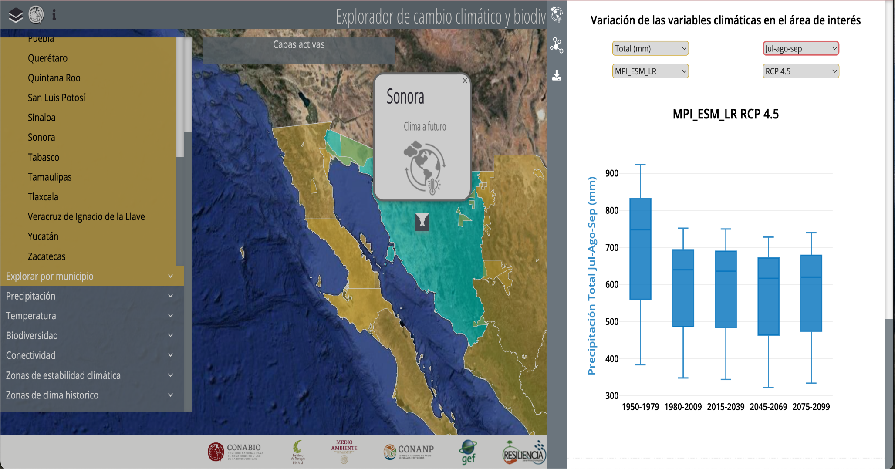
Explorador de Cambio Climático y Biodiversidad What can be obtained easily on-line and ‘off the shelf’
What is presently available on line to visualize IPCC global climate projections regionally.
Shown here is an example from one global model (MPI_ESM_LR) for Sonora.
The value added of this project will be to create more regionalized information that better accounts for precipitation processes. And that may affect the sign of the projection!
https://servicios.conabio.gob.mx/ECCBio/
Notes:
Added value of RCM

Slide 15
Summary comments for climate change in Mexico
IPCC makes its climate projections using a suite of global climate models and emission scenarios
All emission scenarios project warming, that is more profound with higher emissions
Global climate models generally project warming and drying, which will lead to greater propensity for drought and water stress across the whole country.
Precipitation projections are more uncertain, and may change with more regionalized projections using downscaling techniques.
Even if mean precipitation decreases, extreme precipitation events are likely to become more intense, along with their associated hazards.

Slide 16
P3. Climate data. Global and Regional Model datasets
1.NASA Earth Exchange. Global Daily Downscaled Projections (ssp245/ssp585)
Global Climate Model (GCM) | Downscaling Method | Spatial Resolution
CESM2 (NCAR Community Earth System Model version 2) | Statistical Downscaling Algorithm | 0.25° x 0.25°
CESM2-WACCM (CESM2 Whole Atmosphere Community Climate Model)
GFDL-CM4-gr1 (Geophysical Fluid Dynamics Laboratory Climate Model version 4)
GFDL-CM4-gr2 (Geophysical Fluid Dynamics Laboratory Climate Model version 4)
GFDL-ESM4 (NOAA. Geophysical Fluid Dynamics Laboratory Earth System Model version 4)
HadGEM3-GC31-LL (Hadley Centre Global Environment Model in the Global Coupled configuration 3.1)
HadGEM3-GC31-MM (Hadley Centre Global Environment Model in the Global Coupled configuration 3.1)
MPI-ESM1-2-HR (Max-Planck-Institute Earth System Model)
MPI-ESM1-2-LR (Max-Planck-Institute Earth System Model)
2. The North American CORDEX Program (rcp585)
Global Climate Model (GCM) | Downscaling Method | Spatial Resolution
HadGEM2-ES (Hadley Centre Global Environment Model version 2) | RegCM4 (Regional Climate Model 4) | 0.25 ° x 0.25 °
 | WRF (Weather Research and Forecasting)
MPI-ESM-LR (Max-Planck-Institute Earth System Model) | RegCM4 (Regional Climate Model 4)
 | WRF (Weather Research and Forecasting)
GFDL-ESM2M (NOAA. Geophysical Fluid Dynamics Laboratory Earth System Model version 2) | RegCM4 (Regional Climate Model 4)
 | WRF (Weather Research and Forecasting)
3. High-Resolution Pseudo Global Warming WRF Simulations of the Current and Future Climate of North America (PGWWRF-NA)
Global Climate Model (GCM) | Downscaling Method | Spatial Resolution
NA | WRF (Weather Research and Forecasting) | 4 km x 4 km

