Slide 1
Climate assessment for mining operations in Mexico Virtual Workshop: 22-23 May 2023

Slide 2
University of Arizona Land Acknowledgement
Notes:
Climate projection data will be provided for the following variables of interest to Fresnillo:
Seasonal mean temperature: Summer, Winter
Annual minimum temperature
Annual maximum temperature
Annual precipitation
Extreme precipitation (Magnitude and Frequency)
Accumulated extreme precipitation
The first phase of the project will be conducted as a pilot on one Fresnillo mining site. A second phase will then apply the projection methods to the remaining four sites. The specific Fresnillo Mining sites are: Fresnillo, El Saucito, La Cienega, Penmont, and San Julian. The initial pilot site will be Penmont, as this location is physically nearest to Arizona

Slide 3
Objectives of this virtual workshop
Introduce this climate assessment effort more broadly within Fresnillo
Summarize the workflow for climate assessment at mining sites
Hear from Fresnillo on why climate change is important to them
Overview capabilities for potential climate change adaptation in mining industry, through UA Mineral and Geological Engineering
Allow time for dialog and discussion
Notes:
Climate projection data will be provided for the following variables of interest to Fresnillo:
Seasonal mean temperature: Summer, Winter
Annual minimum temperature
Annual maximum temperature
Annual precipitation
Extreme precipitation (Magnitude and Frequency)
Accumulated extreme precipitation
The first phase of the project will be conducted as a pilot on one Fresnillo mining site. A second phase will then apply the projection methods to the remaining four sites. The specific Fresnillo Mining sites are: Fresnillo, El Saucito, La Cienega, Penmont, and San Julian. The initial pilot site will be Penmont, as this location is physically nearest to Arizona

Slide 4
Introduction to participating teams by leads
UA Climate Assessment Team
Core Fresnillo Team
UA Mining and Geological Engineering
Notes:
Climate projection data will be provided for the following variables of interest to Fresnillo:
Seasonal mean temperature: Summer, Winter
Annual minimum temperature
Annual maximum temperature
Annual precipitation
Extreme precipitation (Magnitude and Frequency)
Accumulated extreme precipitation
The first phase of the project will be conducted as a pilot on one Fresnillo mining site. A second phase will then apply the projection methods to the remaining four sites. The specific Fresnillo Mining sites are: Fresnillo, El Saucito, La Cienega, Penmont, and San Julian. The initial pilot site will be Penmont, as this location is physically nearest to Arizona

Slide 5
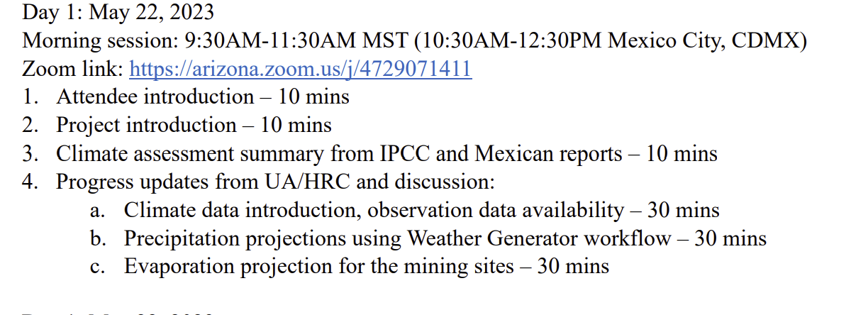
Meeting agenda: Day 1, Monday 22 May
MORNING
AFTERNOON
Notes:
Climate projection data will be provided for the following variables of interest to Fresnillo:
Seasonal mean temperature: Summer, Winter
Annual minimum temperature
Annual maximum temperature
Annual precipitation
Extreme precipitation (Magnitude and Frequency)
Accumulated extreme precipitation
The first phase of the project will be conducted as a pilot on one Fresnillo mining site. A second phase will then apply the projection methods to the remaining four sites. The specific Fresnillo Mining sites are: Fresnillo, El Saucito, La Cienega, Penmont, and San Julian. The initial pilot site will be Penmont, as this location is physically nearest to Arizona

Slide 6
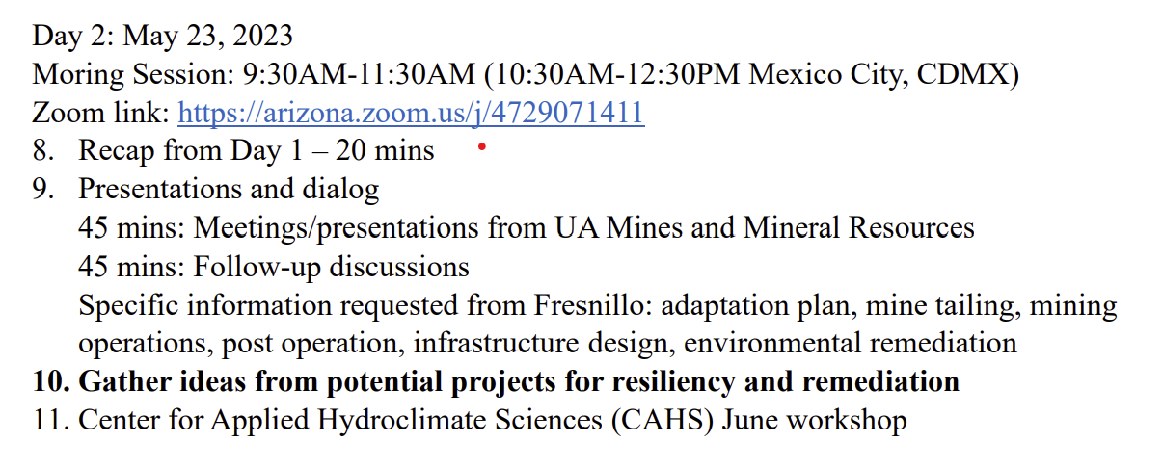
Meeting agenda: Day 2, Tuesday 23 May
MORNING
Notes:
Climate projection data will be provided for the following variables of interest to Fresnillo:
Seasonal mean temperature: Summer, Winter
Annual minimum temperature
Annual maximum temperature
Annual precipitation
Extreme precipitation (Magnitude and Frequency)
Accumulated extreme precipitation
The first phase of the project will be conducted as a pilot on one Fresnillo mining site. A second phase will then apply the projection methods to the remaining four sites. The specific Fresnillo Mining sites are: Fresnillo, El Saucito, La Cienega, Penmont, and San Julian. The initial pilot site will be Penmont, as this location is physically nearest to Arizona

Slide 7
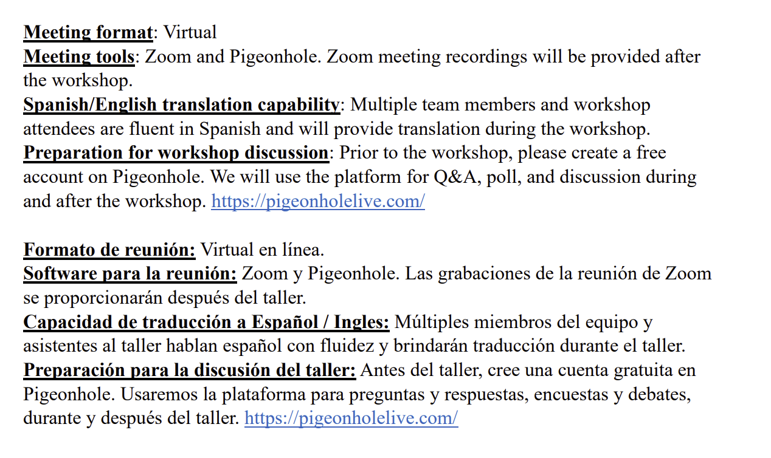
Meeting logistics
Notes:
Climate projection data will be provided for the following variables of interest to Fresnillo:
Seasonal mean temperature: Summer, Winter
Annual minimum temperature
Annual maximum temperature
Annual precipitation
Extreme precipitation (Magnitude and Frequency)
Accumulated extreme precipitation
The first phase of the project will be conducted as a pilot on one Fresnillo mining site. A second phase will then apply the projection methods to the remaining four sites. The specific Fresnillo Mining sites are: Fresnillo, El Saucito, La Cienega, Penmont, and San Julian. The initial pilot site will be Penmont, as this location is physically nearest to Arizona

